Slide 1

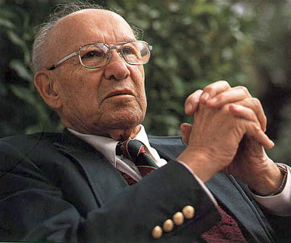
Management by Objectives
MGN-502
Lecture - 03

Slide 2

Faculty Details
01
Course Instructor: Mr. P. B. Narendra Kiran (UID 28647)
Designation: Assistant Professor
Contact : 9182559741
Email: narendra.28647@lpu.co.in

Slide 3
Management by Objective (MBO)
02
The term Management by Objectives was coined by Peter Drucker in 1954 – “The Practice of Management”.
The process of setting objectives in the organization to give a sense of direction to the employees is called as Management by Objectives.
It refers to the process of setting goals for the employees so that they know what they are supposed to do at the workplace.

Slide 4
03
Management by objectives guides the employees to deliver their level best and achieve the targets within the stipulated time frame.
Management by Objectives defines roles and responsibilities for the employees and help them chalk out their future course of action in the organization.

Slide 5
WHAT IS MBO ?
04
Is a systematic and organized approach that allows management to focus on achievable goals and attain the best possible results from available resources.
Aims to increase individual and organizational effectiveness by aligning organizational goals and subordinate objectives.
Clarifies and quantifies objectives to allow for monitoring, evaluation, and feedback throughout the hierarchy of objectives.

Slide 6
05
IN SIMPLE WORDS, MBO IS…
MBO emphasises the importance of objectives as A tool to be used by managers in fulfilling their managerial roles (accomplish their tasks).
Divide problem into manageable, “bite-size” chunks.

Slide 7
Framework of MBO
06
Supervisor
Individually Act
Perform task
(subordinate)
Provide Support
(Supervisor)
Jointly Plan
Set Objectives
Set Standards
Choose Actions
Jointly Control
Review results
Discuss Implementations
Review MBO cycle
and
Subordinate
by Peter F Drucker in 1954

Slide 8
07
Core Concepts
According to Drucker managers should "avoid the activity trap", getting so involved in their day to day activities that they forget their main purpose or objective. Instead of just a few top managers, all managers should:
Participate in the strategic planning process, in order to improve the implement ability of the plan, and Implement a range of performance systems, designed to help the organization stay on the right track.

Slide 9
08
Managerial Focus
MBO managers focus on the result, not the activity. They delegate tasks by "negotiating a contract of goals" with their subordinates without dictating a detailed roadmap for implementation.
Management by Objectives (MBO) is about setting yourself objectives and then breaking these down into more specific goals or key results.

Slide 10
09
Main Principle
The principle behind Management by Objectives (MBO) is to make sure that everybody within the organization has a clear understanding of the aims, or objectives, of that organization, as well as awareness of their own roles and responsibilities in achieving those aims.
The complete MBO system is to get managers and empowered employees acting to implement and achieve their plans, which automatically achieve those of the organization.

Slide 11
MBO PRINCIPLES
10
Cascading of organizational goals and objectives
Specific objectives for each team member
Participative decision making
Explicit time period
Performance evaluation & feedback

Slide 12
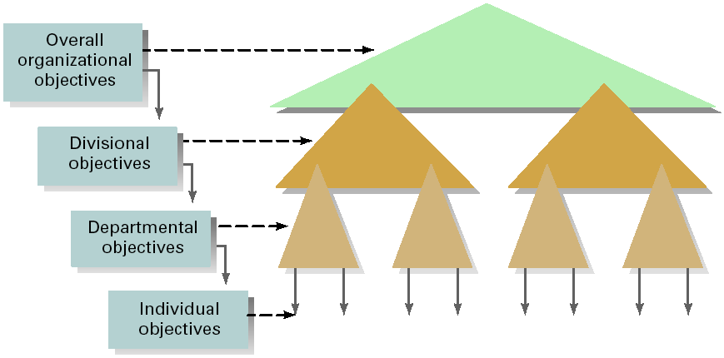
CASCADING OF OBJECTIVES
11

Slide 13
Where to Use MBO?
12
The MBO style is appropriate for knowledge-based enterprises when your staff is competent.
It is appropriate in situations where you wish to build employees' management and self-leadership skills and tap their creativity, tacit knowledge and initiative.

Slide 14
ADVANTAGES OF MBO
13
Improves employee motivation
Improves communication in the organisation
Flags up and highlights training needs required to achieve objectives
Improves overall performance and efficiency
Attainment of goals can lead to the satisfaction of Maslow’s higher order needs

Slide 15
STEPS FOR MBO
14
STEP 1: SET GOALS
STEP 2: DEVELOP PLANS
Corporate Strategic goals
Departmental goals
Individual goals
Action Plans
Review Progress & Take Corrective Action
STEPS FOR MBO
Appraise Performance
STEP 3: REVIEW PROGRESS
STEP 4: APPRAISE OVERALL PERFORMANCE
Notes:
Set goals – not day to day but rather goals that answer at least a portion of the “where are we going” question and then are linked with other goals
Plans – Steps required
Review – make sure plan is working; Is corrective action necessary either in the plan or the execution?
CAUTION: Don’t get locked into PREDETERMINED behavior or sacrifice QUALITY to “MEET” goal

Slide 16
UNDERLYING PURPOSES OF MBO
15
Clarify organization’s goals and plans at all levels.
Gain better motivation and participation from organization’s members.

Slide 17
MCQ
16
Management by Objective (MBO) is also known as
(A) Management by results
(B) Management by goals
(C) Management by planning
(D) Management by evaluation

Slide 18
Thank You
17

